Slide 1


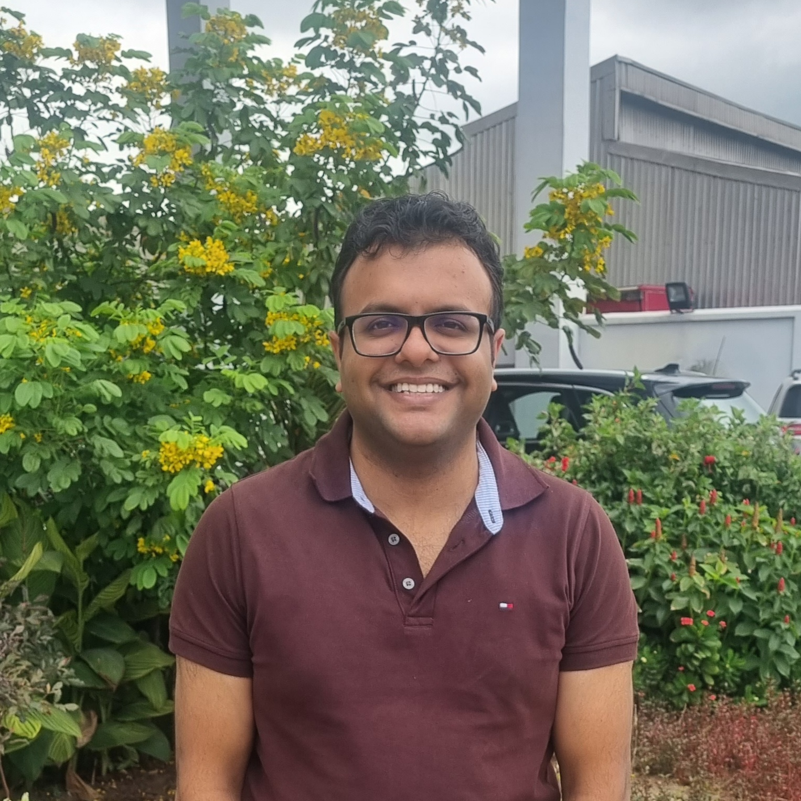
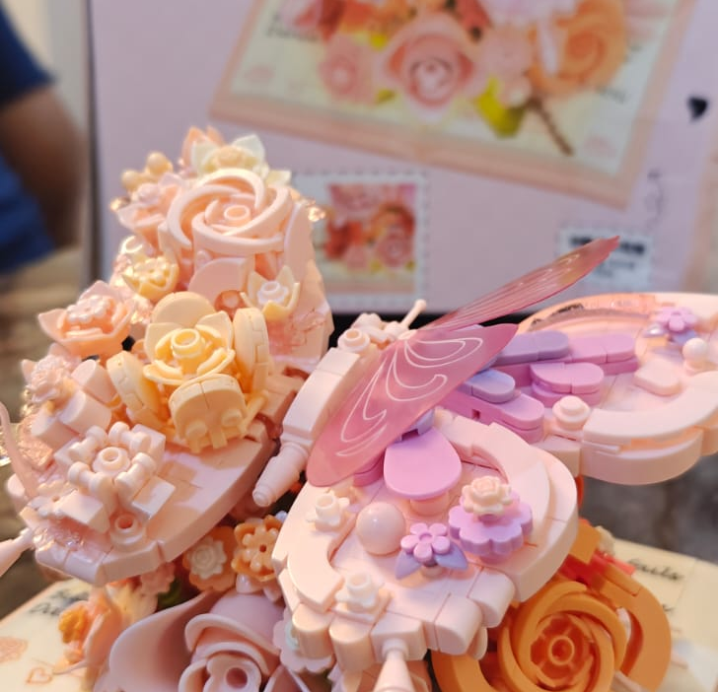
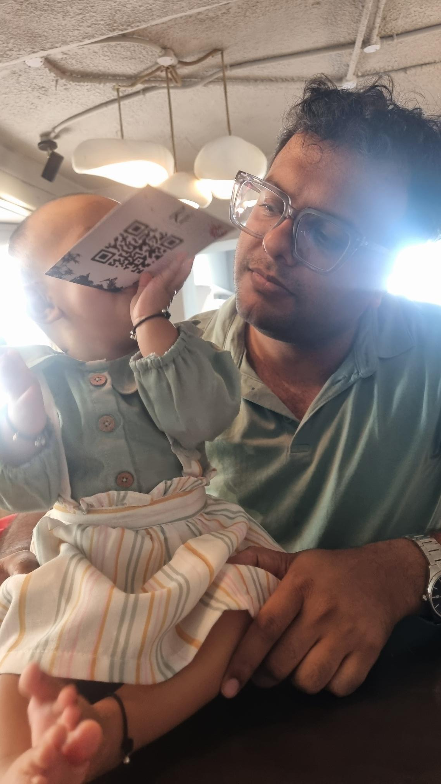
Getting to Know Me
Work
Personal
My role
Country FC - Nigeria
Significant others / family members / furry friends in my life
My wife – Radhika, My Twins – Hitansh, Hitishaa and my family in India
Tenure in ofi/Olam
9 Years
How I enjoy spending my free time
Fun time with Family, Movie, Lego
Previous companies I have worked at
Diageo, Vedanta
My favorite / comfort food
Chinese, Rajma Chawal
Why I joined ofi/Olam and what keeps me here?
The Opportunities and growth of the company has always fascinated me along with the role that I get do here, never before.
My favorite song
Lost Stars
Hitesh Agarwal
Bugsy
Movie Buff – Saw 7 movies on a fine Sunday
Can take perfect normal calls even when fully asleep
Applied to Netflix many years back for a job rating new/old content
This is me outside work, doing stuff I enjoy in my life …

